Slide 1
Heart Failure Prediction
-Group 12

Slide 2
Project name: Heart Failure Prediction | Project leader: Bhupathiraju Haripriya
Problem statement:Regardless of age, heart attacks are a prevalent ailment that many people today experience. Heart failure is caused by a number of factors, including smoking, drinking, and a patient's prior medical history, including blood pressure, sugar levels, and cholesterol. This highlights the need of early heart disease detection. We will therefore use Naive Bayes to predict, using these various characteristics, the likelihood that a person would get heart disease. | Project goal: Goal is to build a machine learning model that classifies weather a person suffers from heart failure or not using the various given input attributes
Project scope: The classification model we'll be using naive bayes that makes use of the Bayes theorem. With the use of this machine learning algorithm, individuals can estimate their risk of developing heart failure. . | Benefits: Early heart disease identification can save lives. increasing awareness of a healthy lifestyle by displaying data analysis
Team members: Group-12 Siddharth Gomatam Srinivasan -1002069471 Nadella kailash -1002065981 Vamsi krishna reddy -1002074642 Pavan Sai Akula -1002082165 Haripriya Bhupathiraju -1002075931 | Reference: https://www.geeksforgeeks.org/naive-bayes-classifiers/ https://www.kaggle.com/andrewmvd/heart-failure- clinical-datahttps://doi.org/10.1186/s12911-020-1023-5 https://www.geeksforgeeks.org/naive-bayes-classifiers/ https://www.cdc.gov/heartdisease/facts.htm

Slide 3
MODEL SELECTION-
Heart failure is caused by a number of factors, including smoking, drinking, and the patient's prior medical history, including blood pressure, sugar levels, and cholesterol. This underlines the significance of early detection of heart illness.
Construction of a Naive Bayes model is the primary objective of the proposed study. Regardless of age or gender, we will predict whether a person will develop heart disease based on a number of factors.
We collected the data set from Kaggle.

Slide 4
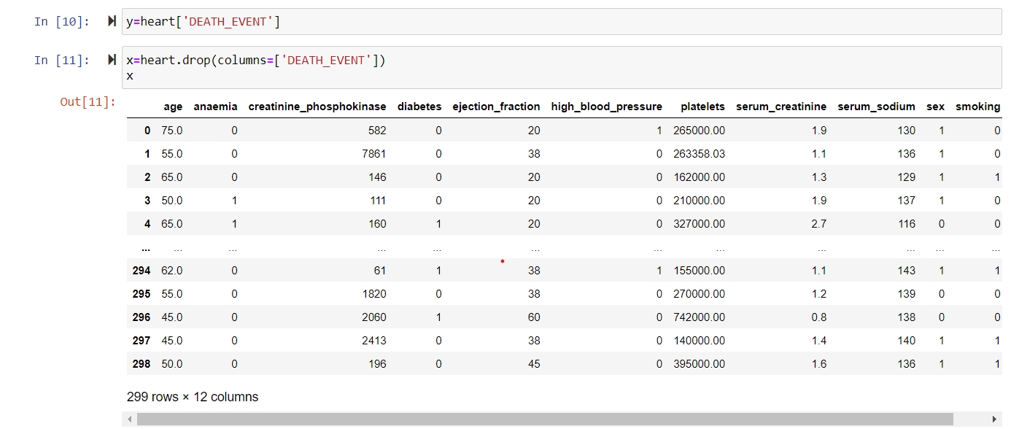
PREDICTIVE MODEL ANALYSIS-

Slide 5
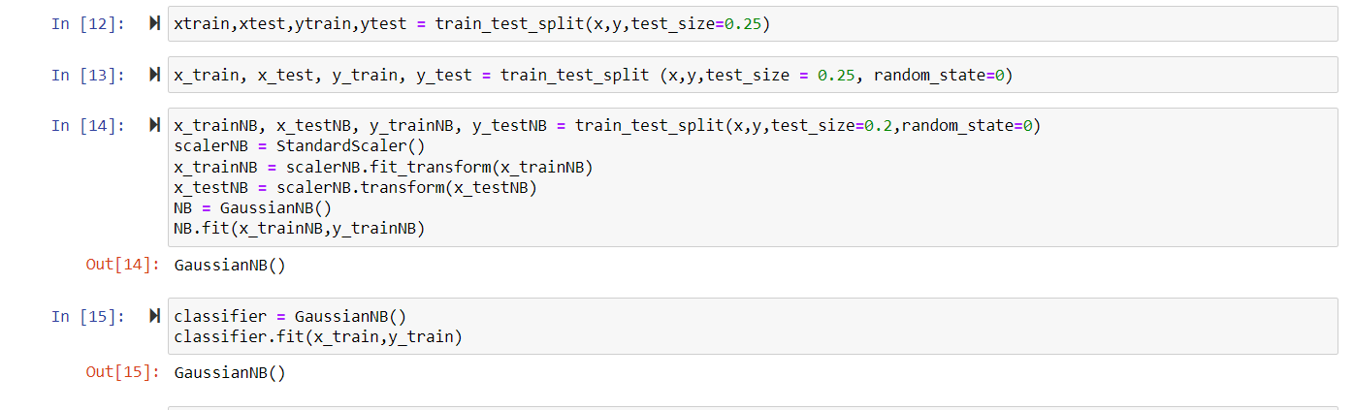

Slide 6
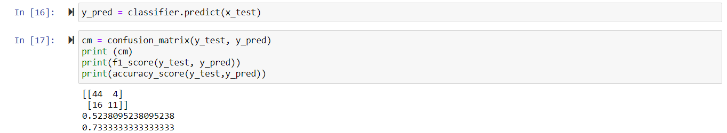
PREDICTION-

Slide 7
Conclusion and Recommendations-
Using the Naive Bayes model, the suggested study was able to successfully predict heart disease with a prediction percentage of 73%. When the user enters all the numbers for the factors, such as age, sex, cholesterol, chest discomfort, etc., we will design and publish a website where they can check the forecast themselves. The user will be able to determine his prediction percentage by entering these variables.
https://www.geeksforgeeks.org/naive-bayes-classifiers/ https://www.kaggle.com/andrewmvd/heart-failure- clinical-datahttps://doi.org/10.1186/s12911-020-1023-5
https://www.geeksforgeeks.org/naive-bayes-classifiers/ https://www.cdc.gov/heartdisease/facts.htm

Slide 8
THANK YOU
Siddharth Gomatam Srinivasan -1002069471
Nadella kailash -1002065981
Vamsi krishna reddy -1002074642
Pavan Sai Akula -1002082165
Haripriya Bhupathiraju -1002075931

